Slide 1



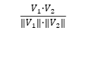
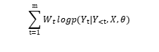
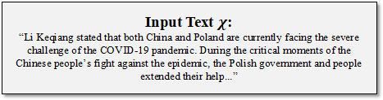
Input Text $χ$:
“Li Keqiang stated that both China and Poland are currently facing the severe challenge of the COVID-19 pandemic. During the critical moments of the Chinese people’s fight against the epidemic, the Polish government and people extended their help...”
DetectGPT-SC
(1) Mask
(2) Prediction
(3) Compare
BARTScore:
mask sentence1
$$\sum_{t=1}^{m}{W_{t}}logp(Y_{t}|Y_{<t},X,θ)$$
$$χ$$
mask sentence2
ChatGPT
Word2Vec (Cosine):
mask sentence3
$$\frac{V_{1}·V_{2}}{\left\|V_{1}\right\|·\left\|V_{2}\right\|}$$
$χ$ from ChatGPT
$χ$ from Human
🤖
🙋‍️

